Slide 1
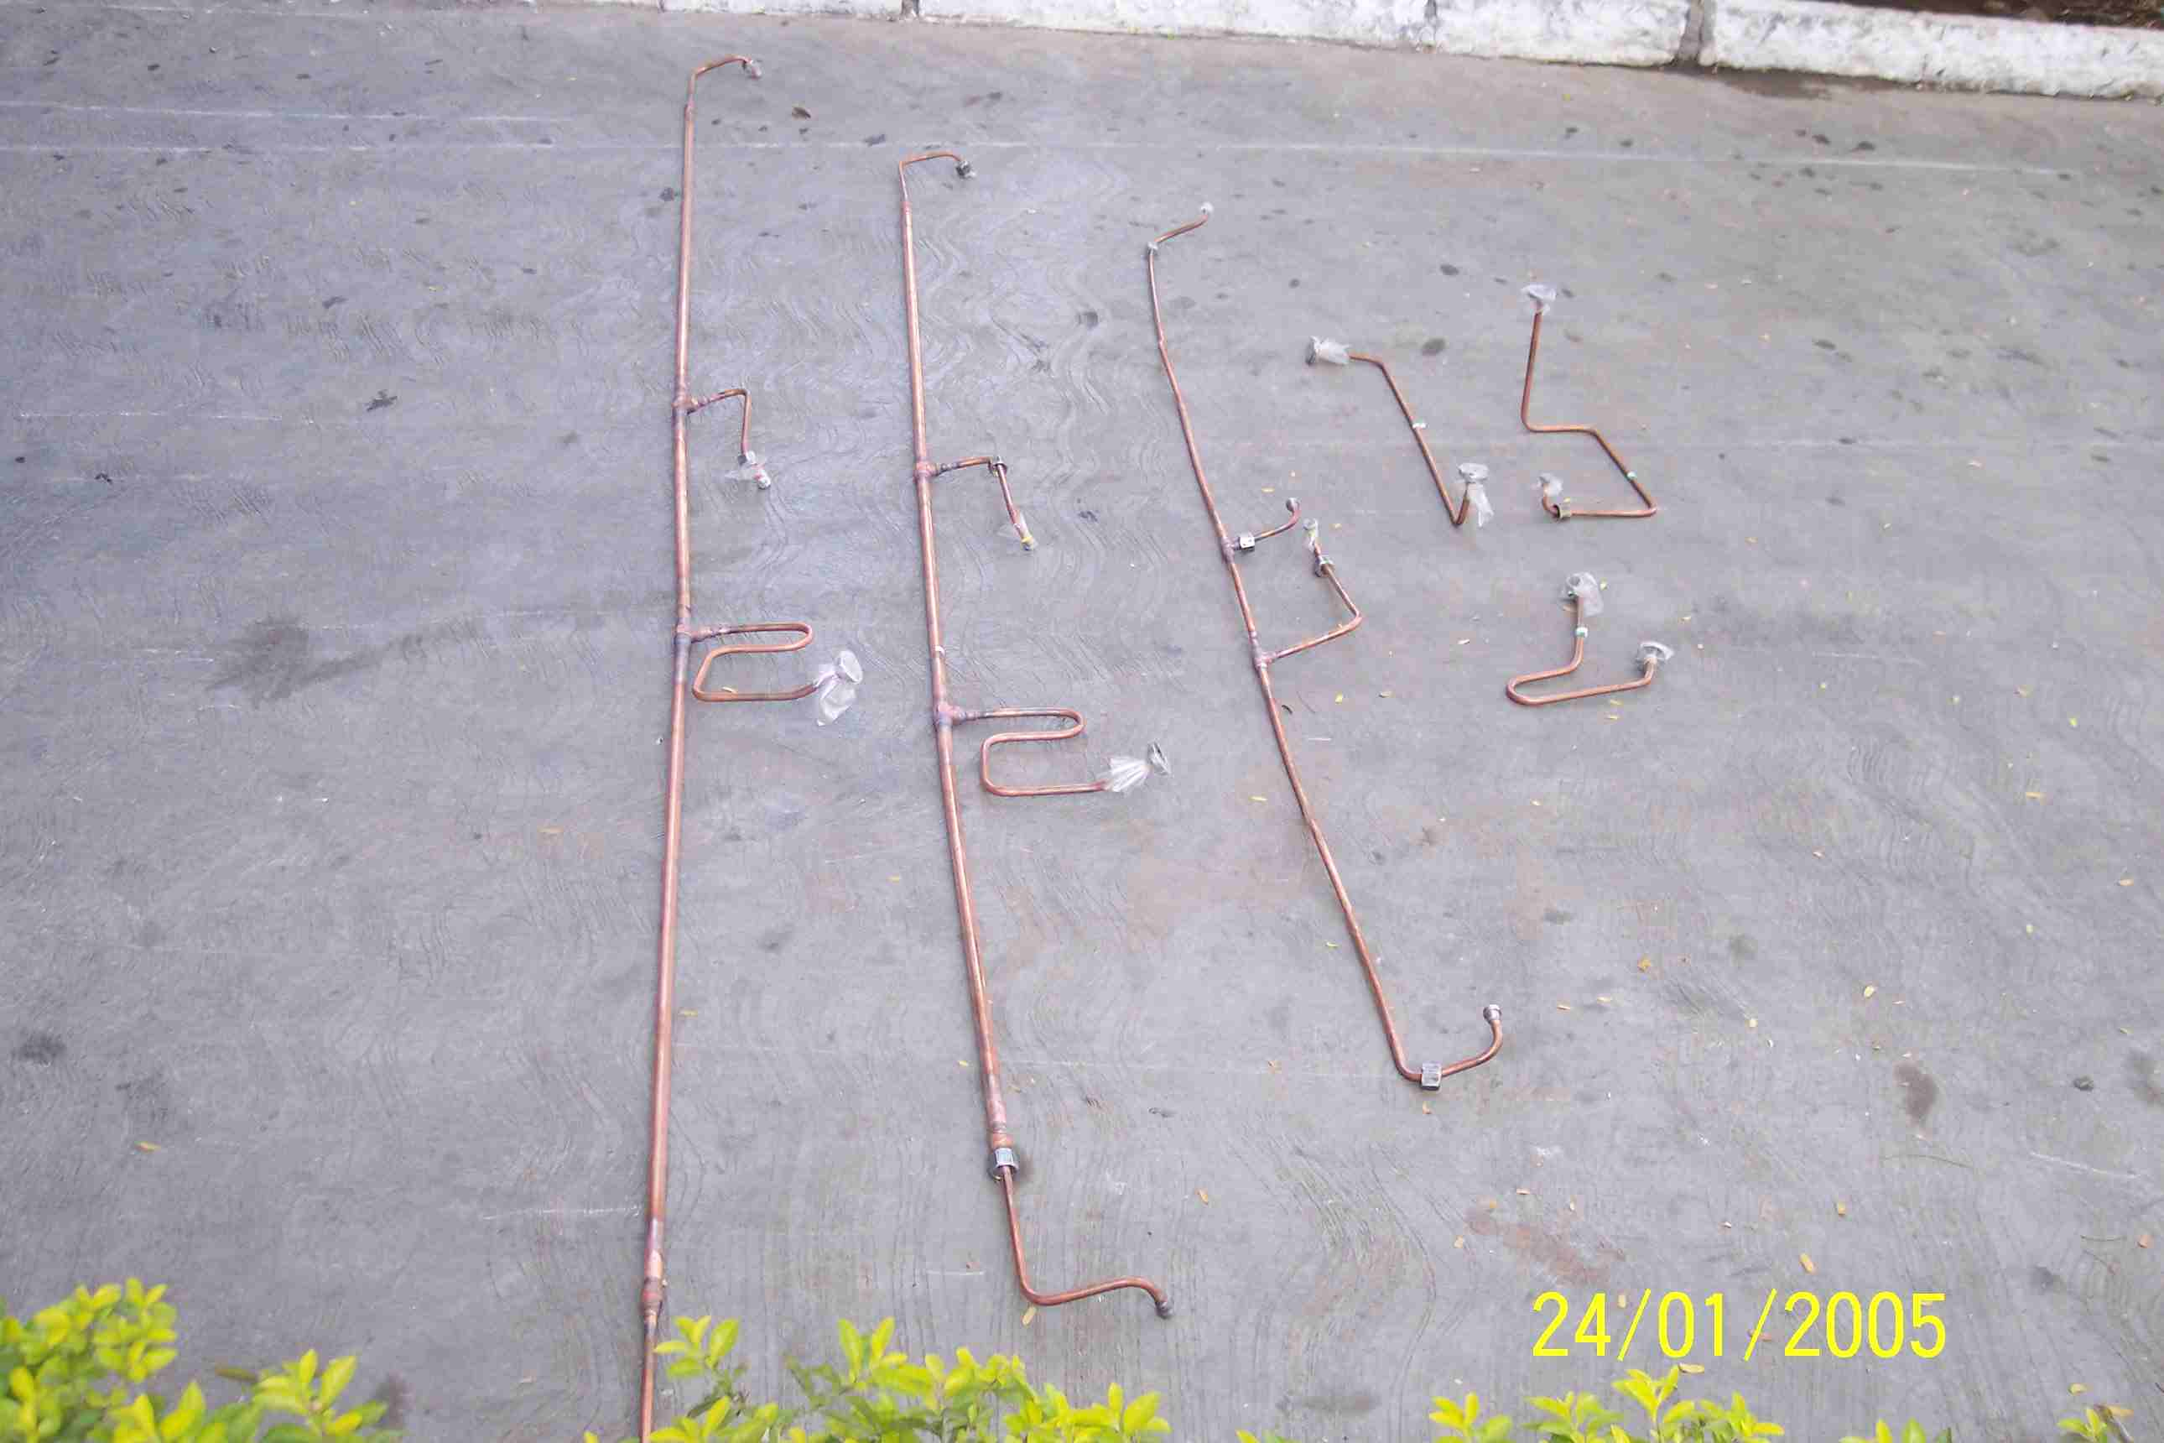
SIEMENS
HVCB SPARES
Big Gas Pipe 145KV,40KA
S4804929001
Big Gas Pipe 72.5KV,40KA
S4804929002
Big Gas Pipe 72.5KV,31.5KA
S4809051001

